Slide 1
Product Presentation

Slide 2
About ZENON
Since 1985, Zenon has been a provider of quality outdoor furnishings and amenities
Customer service is our top priority
We represent over 20 high quality manufacturers from around the country
We provide products to the municipality, park districts, food services, and commercial property management
Our goal is to provide clients with a wide selection of design possibilities

Slide 3
Architectural Park & Streetscape Products
Park Shelters
Gazebos
Bike Racks & Bicycle Parking Systems
Interpretive Signs
Architectural Streetscape Amenities
Planters
Playground Equipment & Safety Surfacing
Benches
Picnic Tables
Receptacles
Plaza & Deck Furniture
Tree Grates
Paver Grates
Notes:
----- Meeting Notes (3/28/16 14:46) -----
playground equipment and safety
(left)
park shelters, gazebos
(right)
drop planters down
tree grates on left side

Slide 4
Manufacturers We Proudly Represent:

Slide 5
Shelters, Gazebos & Pergolas

Slide 6
Specializes in the manufacturing of shelters, gazebos, pergolas and other park structures
Coverworx offers a complete line of standard models and sizes, as well as, customization options
6-stage process that includes an epoxy TGIC powder coating zinc rich primer

Slide 7
Types of Shelters
STEELWORX
Steel Frame Structure
WOODWORX
Wood Frame Structure
Electrical accommodations can be made for all shelter types
Notes:
----- Meeting Notes (3/28/16 14:46) -----
color the word steel frame structure (blue) and woodworx (wood color)
needs to move automatically

Slide 8
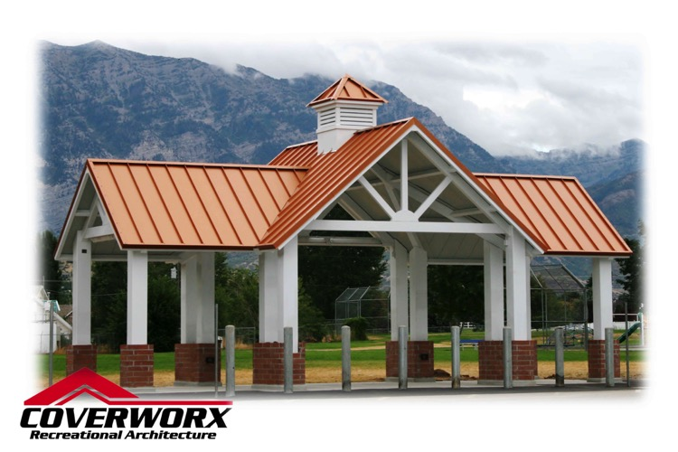
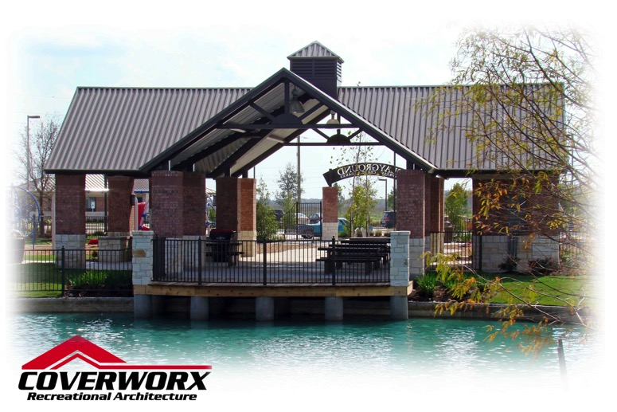
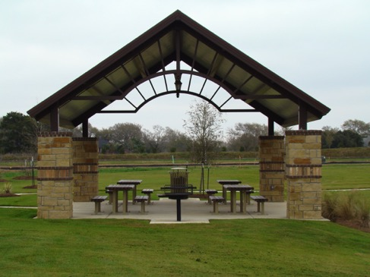
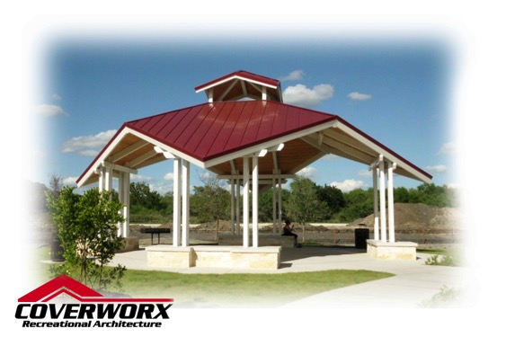
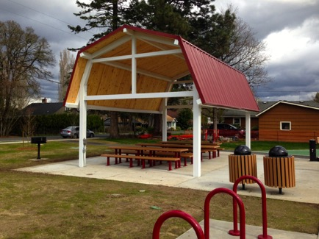
Gable Shelters

Slide 9
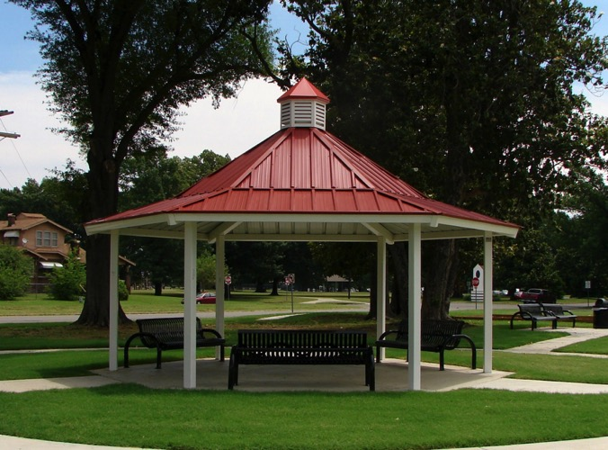
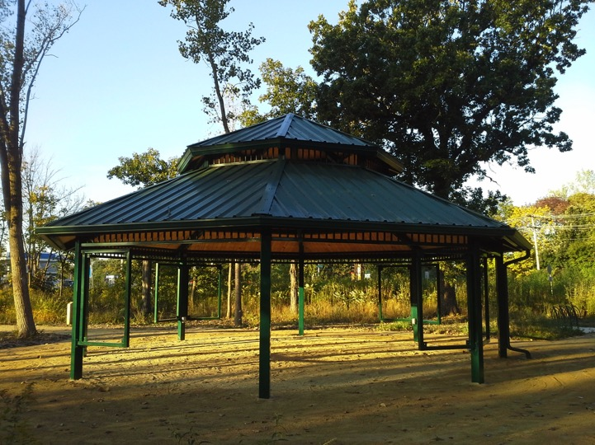
Hexagon Shelters
Octagon Shelters
Notes:
----- Meeting Notes (3/28/16 14:46) -----
5 second crossover on all these

Slide 10
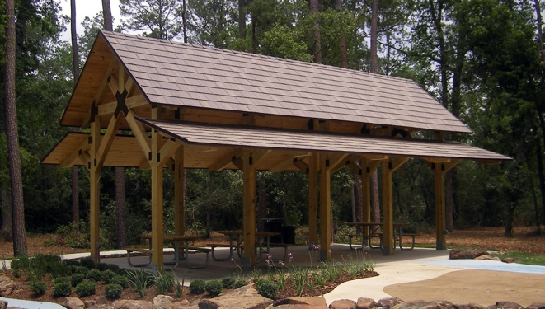
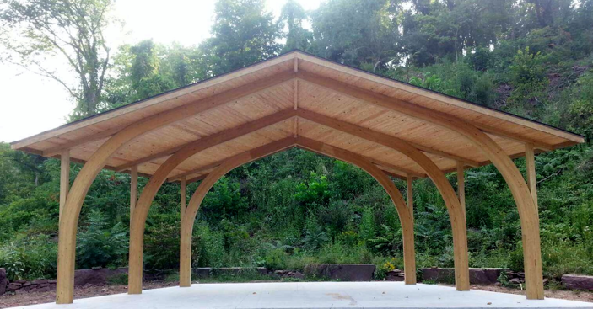
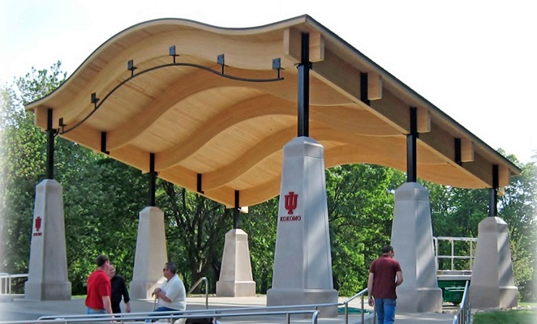
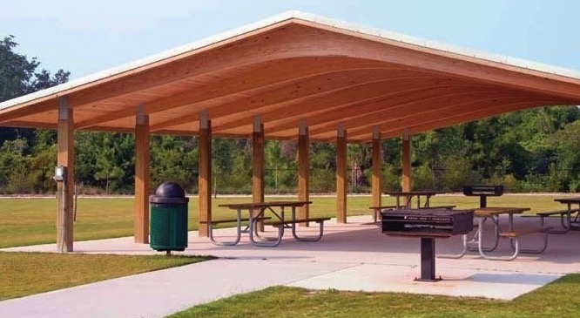
Wood Shelters

Slide 11
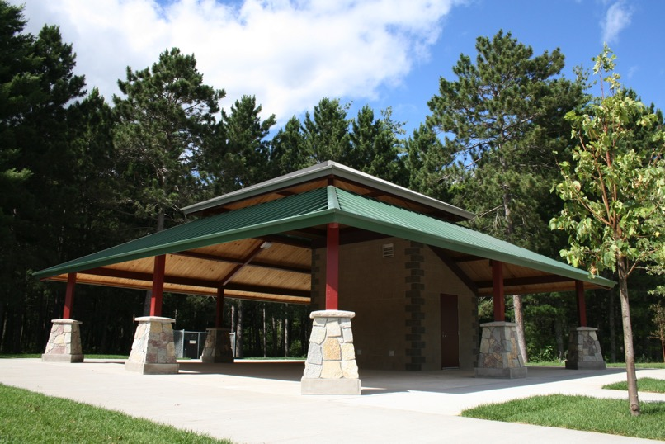
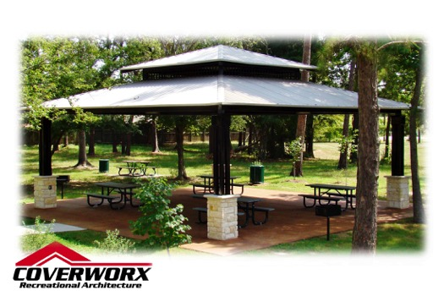
Hip Shelters

Slide 12
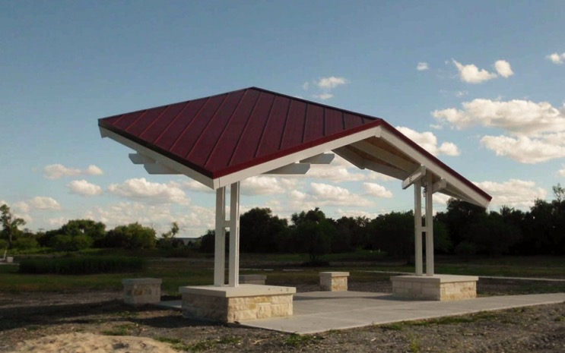
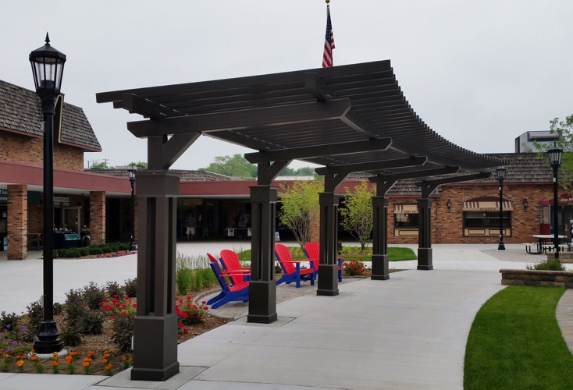
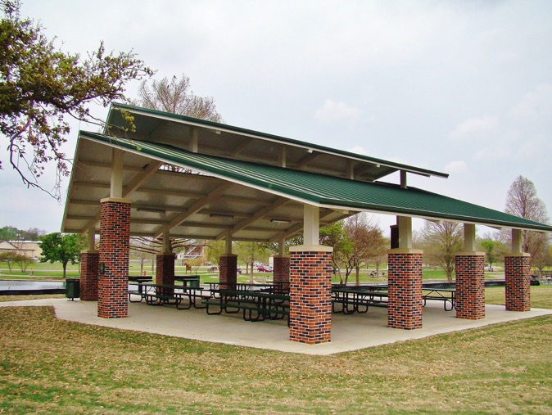
Custom Designs

Slide 13
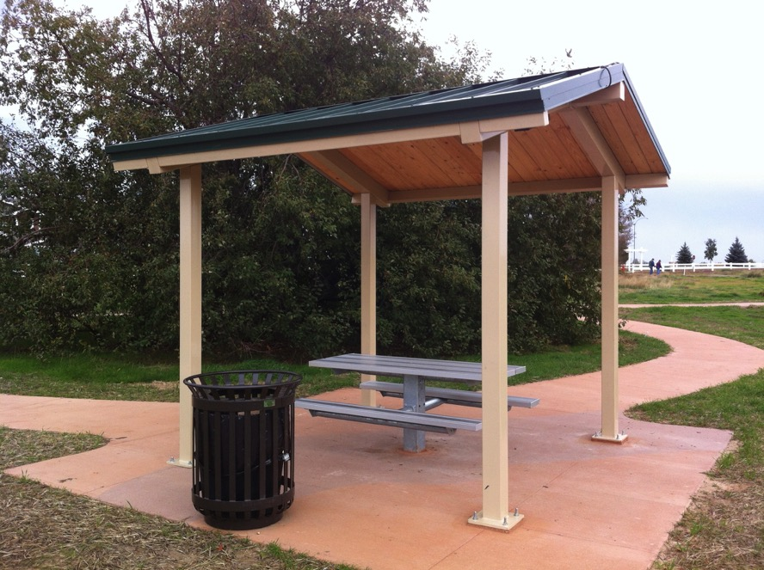
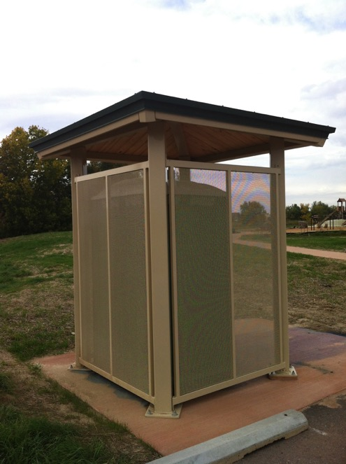
Specialty Shelters

Slide 14
Coverworx products come with a 10 year Limited Warranty!!*
Notes:
----- Meeting Notes (3/28/16 14:46) -----
coverworx products comes with a 10 year...
do something with word coverworx (matches logo)
take the star off

Slide 15
Color Options
27 color options for you to choose from!

Slide 16
Playground Systems
Notes:
----- Meeting Notes (3/28/16 14:46) -----
logo needs to be changed

Slide 17
For over 21 years, Krauss Craft, Inc., manufacturer of Playcraft Systems, has strived to produce the finest playground equipment in the industry
From steel fabrication, Play-Tuff™ coated steel decking to Roto-molded plastic production, Playcraft Systems has a track record for quality products

Slide 18
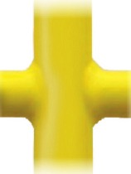
Playcraft Systems places its products through a step by step process to insure a superior fit and finish:
They finish the process with a 2nd layer of powder coating, giving it a lustrous, beautiful sheen and a highly durable finish, providing Playcraft Systems products with the
THICKEST COATING IN THE INDUSTRY, creating:
The Playcraft Systems Difference

Slide 19
The Playcraft Systems Difference
Playcraft Systems insures the quality of its products through a variety of details:
Extra Thick Powder Coatings
Double coated metal components allow for Playcraft products to better withstand outdoor elements
Innovative King-Clamp™ System
Patented mounting and clamping system utilizes strong precision die-cast components and eliminates clamp stacking
Stainless Steel Hardware
Playcraft offers one of the largest and most innovative selections of hardware backed with a lifetime warranty
Advanced Plastic Components
Hot color-compounded resins and manufacturing expertise ensure greater strength and durability, color-fastness and U.V. resistance on all Roto-molded products

Slide 20
Playcraft Systems Warranty
LIFETIME LIMITED WARRANTY on all stainless steel hardware, metal posts, aluminum posts, aluminum caps and aluminum clamps against structural failure due to natural deterioration or corrosion, or defects in materials or workmanship.
TWENTY-FIVE (25) YEAR LIMITED WARRANTY on all cast aluminum Spring Rider castings against structural failure due to defects in materials or workmanship.
FIFTEEN (15) YEAR LIMITED WARRANTY on all metal rails, metal slides, handles, rungs, loops and walls, all Play-Tuff™ coated perforated steel decks, steps, and bridges, all rotationally molded and HDPE sheet plastic components, excluding recycled plastic components, against structural failure due to defects in materials or workmanship.
TEN (10) YEAR LIMITED WARRANTY on all shade canopy fabric made of UV Stabilized HDPE monofilament yarn and tape against significant fading.
TEN (10) YEAR LIMITED WARRANTY on all Play-Cord™ components against breakage.
FIVE (5) YEAR LIMITED WARRANTY on all Play-Cord™ components against failure due to defects in materials or workmanship.
THREE (3) YEAR LIMITED WARRANTY on all springs, moving swing parts, swing seats and other swing components, as well as all recycled plastic components against failure due to defects in materials or workmanship.
ONE (1) YEAR LIMITED WARRANTY on any other product or part not specifically covered above against failure due to defects in materials or workmanship.

Slide 21
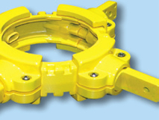
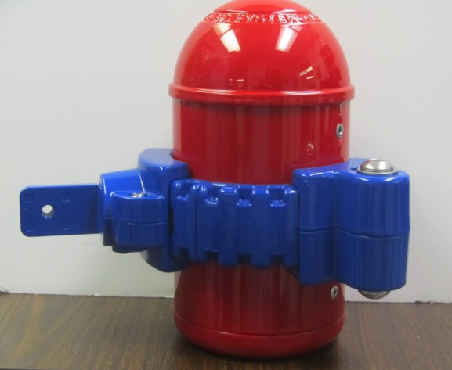
King-Clamp™ System:
Playcraft Systems patented King-Clamp™ mounting and clamping system utilizes super-strong precision die-cast aluminum components and reduces or eliminates clamp stacking by allowing the attachment of multiple components on a single collar.

Slide 22
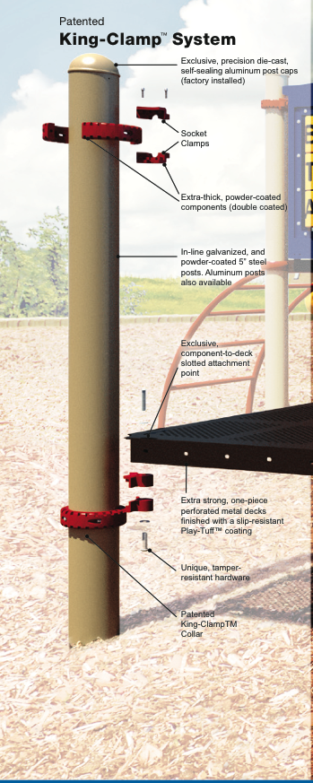
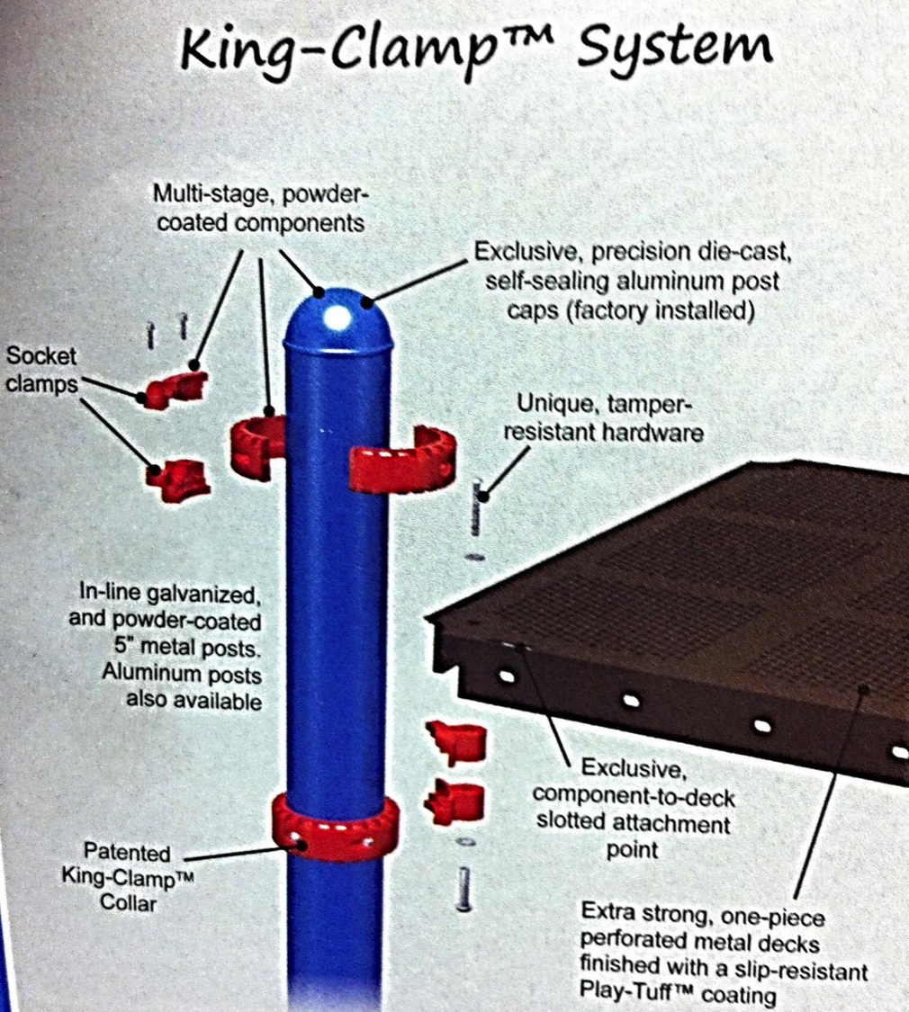

Slide 23
King-Clamp™ system eliminates 20% of clamp requirements compared with competitors systems

Slide 24
Three components on one clamp!

Slide 25
Playground Systems

Slide 26
Modular Systems
Available in two sizes, 5” and 3.5” diameter heavy-duty posts. Both systems are available in standard or custom designs. These post & deck systems are fun and easy for children to play. Traditional systems can be configured to any size or age group.

Slide 27
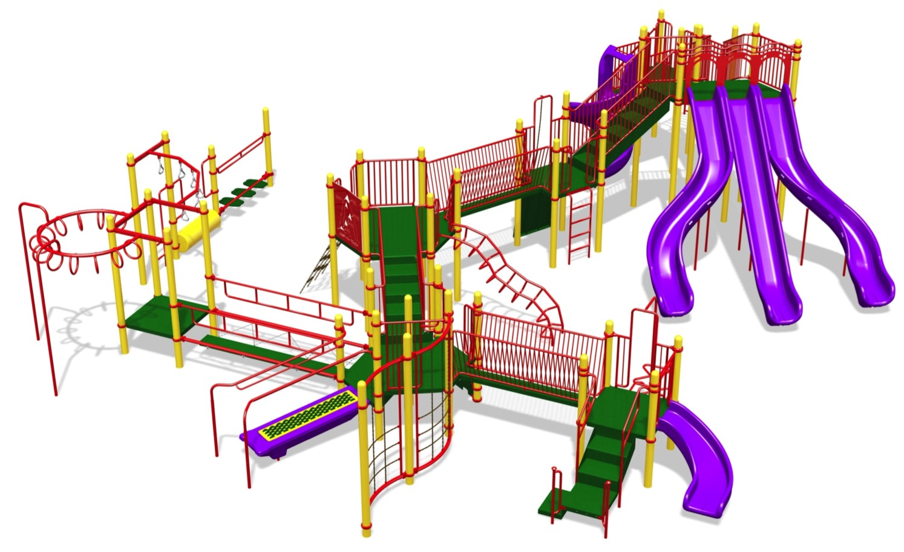
Modular-5”

Slide 28
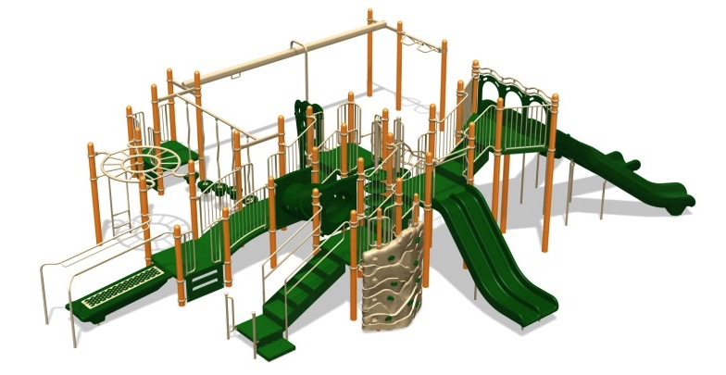
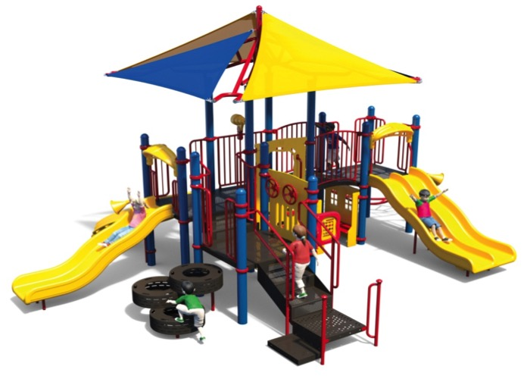
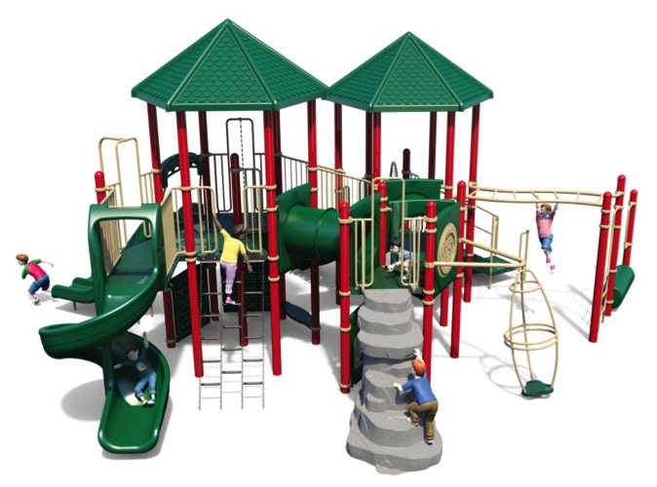
Modular-5”

Slide 29
Modular-3.5”

Slide 30
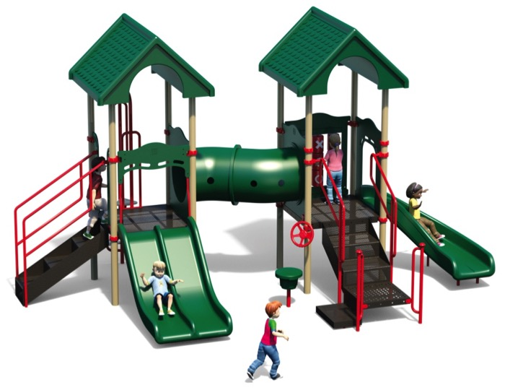
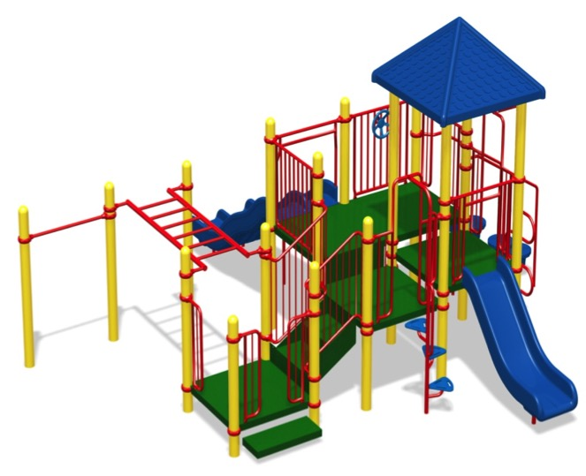
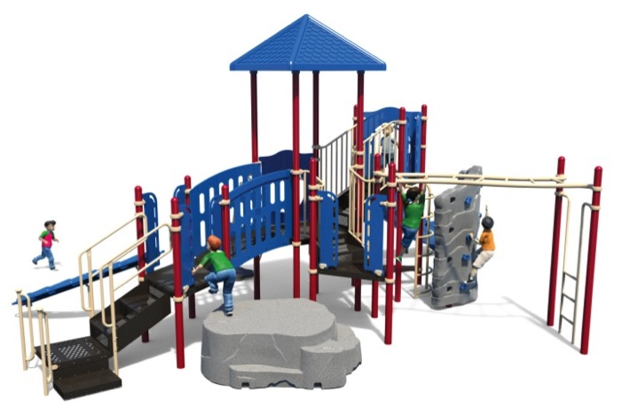
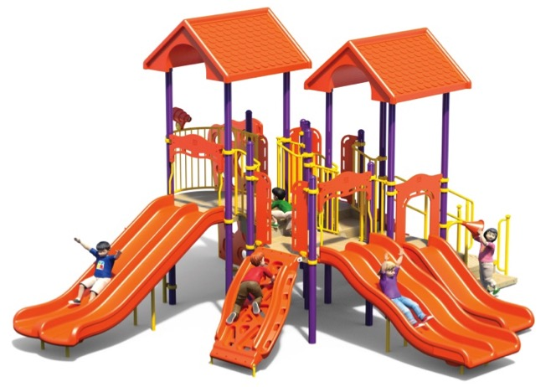
Modular-3.5”

Slide 31
Revolution™
New and advanced deck-less playground system that uses climbing components to make a more challenging, fitness oriented play-structure. Revolution™ incorporates many of the traditional play system activities, without the standard post & deck design or clamps, challenging kids to exercise in a fun environment.
Notes:
----- Meeting Notes (3/28/16 14:46) -----
10 seconds

Slide 32
Revolution™

Slide 33
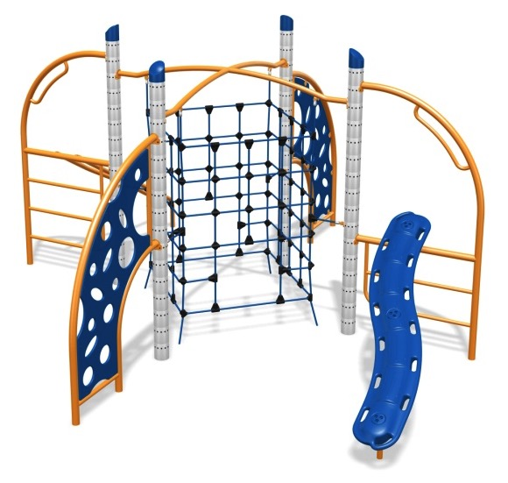
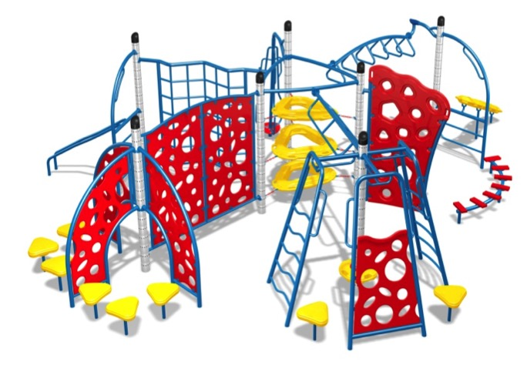
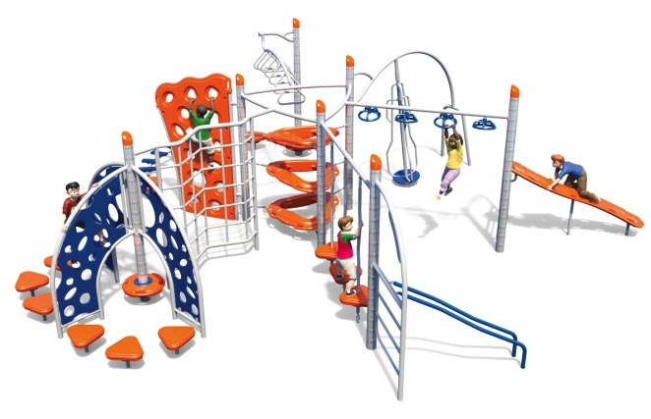
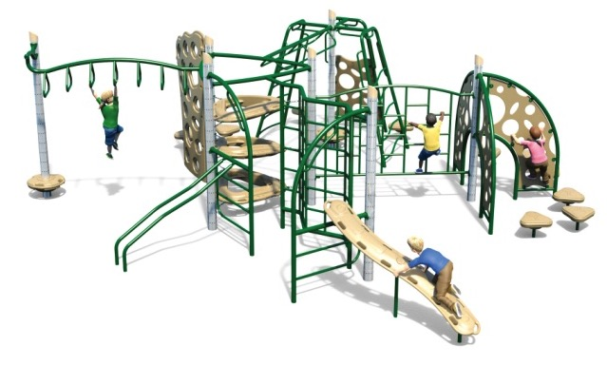
Revolution™

Slide 34
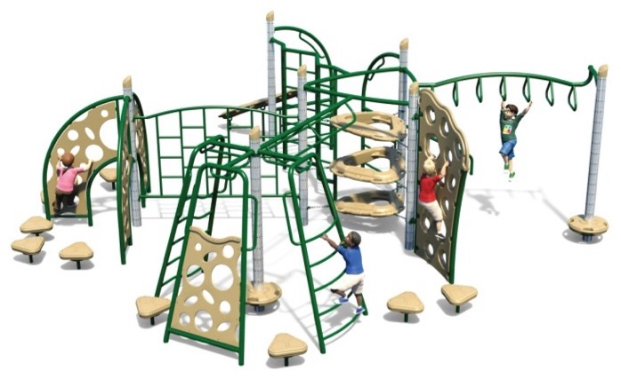
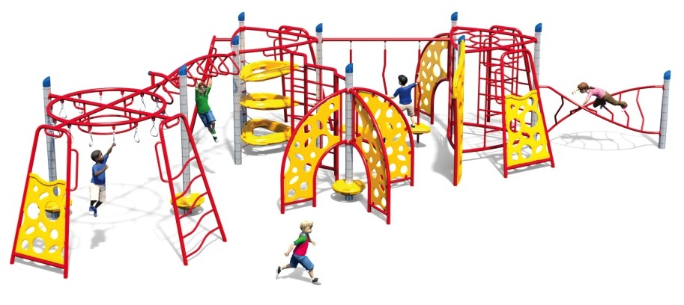
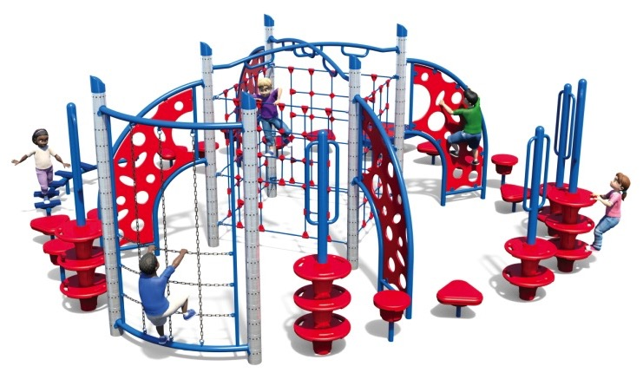
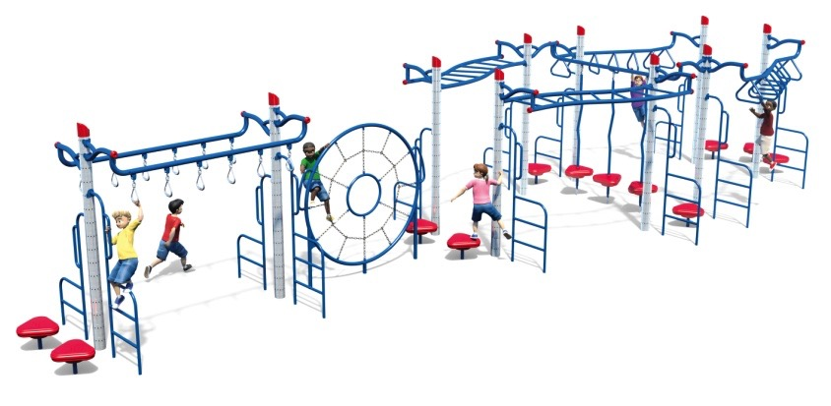
Revolution™

Slide 35
Revolution™ Hybrid
The hybrid series combines the two systems; modular and Revolution™. The use of post & deck in addition to challenging climbing components creates a unique playground system for children to utilize.

Slide 36
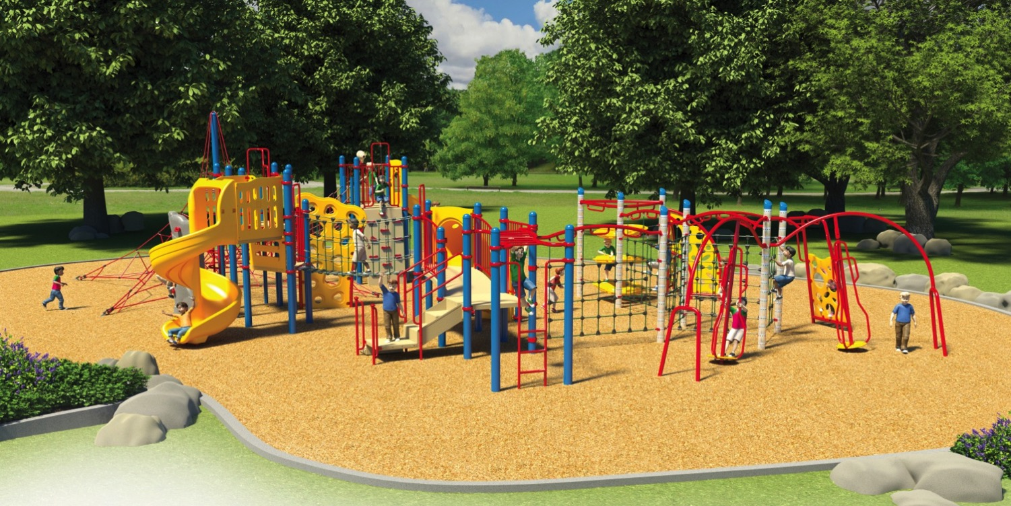
Revolution™ Hybrid

Slide 37
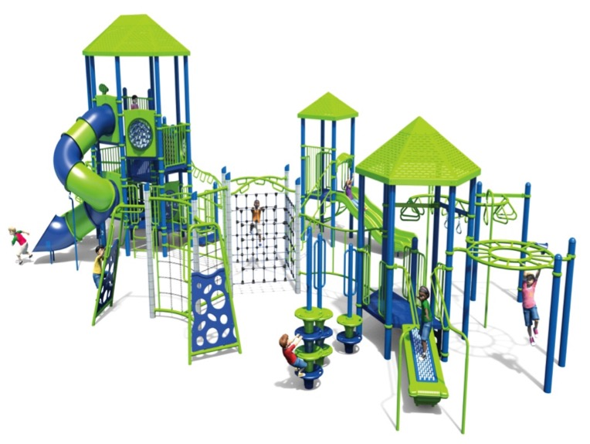
Revolution™ Hybrid

Slide 38
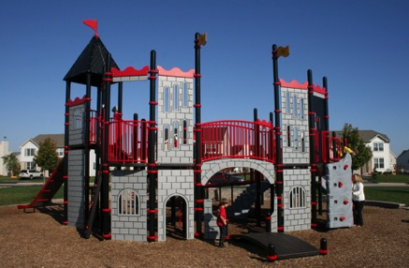
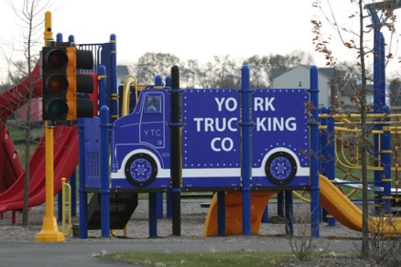
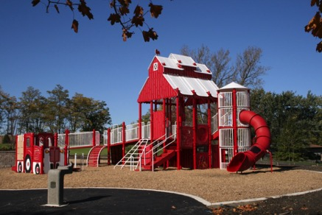
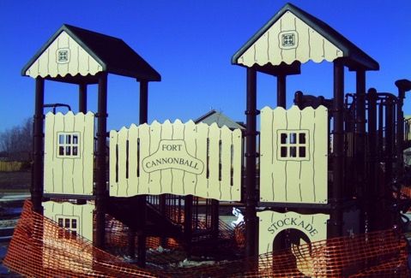
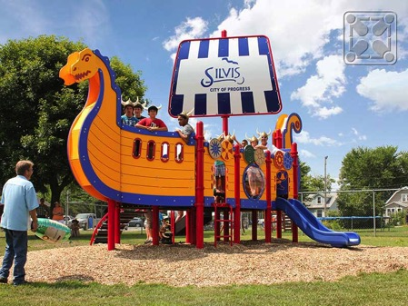
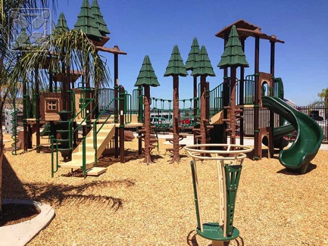
Themed Playgrounds
Castle Theme
City Theme
Farm Theme
Fort Theme
Viking Theme
Treehouse Theme
Notes:
----- Meeting Notes (3/28/16 14:46) -----
bring 1st pic faster

Slide 39
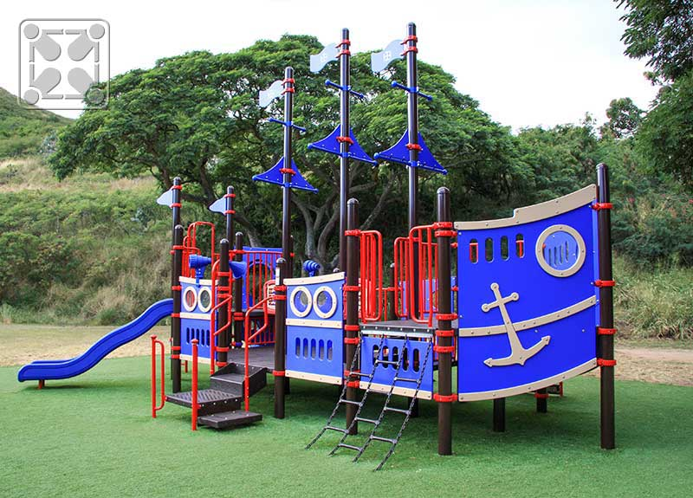
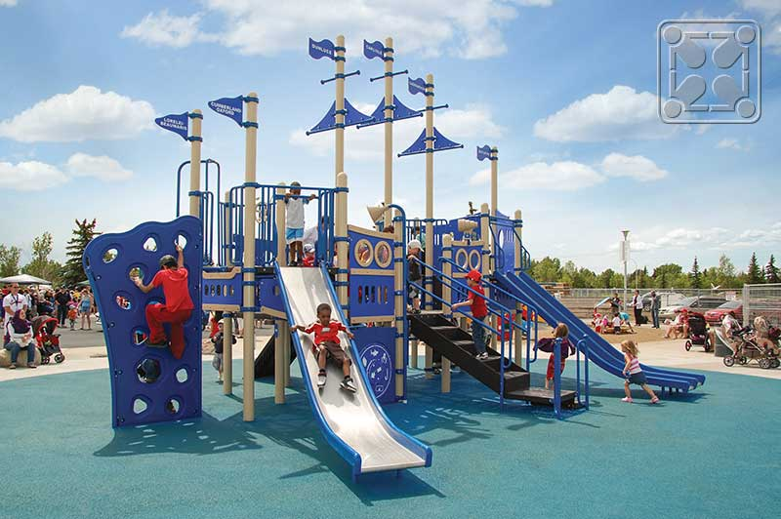
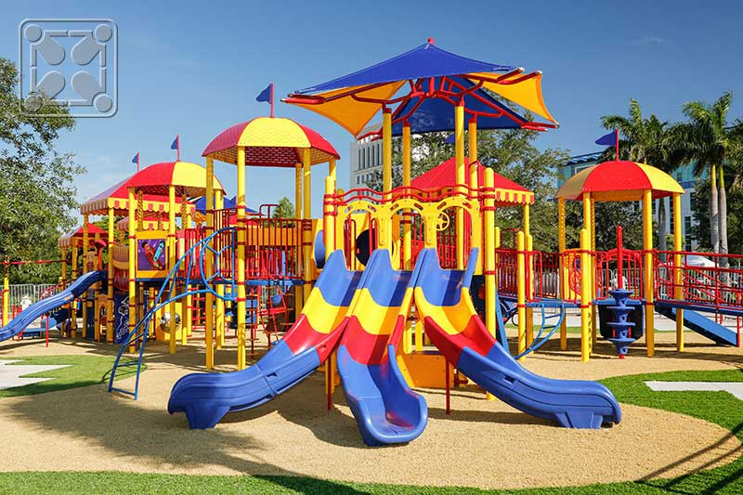
Themed Playgrounds
Riverboat Theme
Nautical Theme
Circus Theme
Fishing Ship Theme
Notes:
----- Meeting Notes (3/28/16 14:46) -----
nautical theme
add a theme page (10 themes)
playcraft catalog

Slide 40
MORE Themed Playgrounds!
Aviation Theme
Fishing Village Theme
Lighthouse Theme
Locomotive Theme
Music Theme
Rocket Theme
Theatre Theme
Watchtower Theme

Slide 41
New Products
UltraZip
Rumble Deck
Gyro-Capsule Spinner
Notes:
----- Meeting Notes (3/28/16 14:46) -----
check for new products in playcraft

Slide 42
Thunder Dome
Transfer Station w/ Kiddie Conveyor
Spin MAX Pod
Metal and fabric roof components

Slide 43
PlayShare Swing

Slide 44
Sling Net Link
Twist Net Climber
And more!

Slide 45
Color Options
Powder Coatings
Roto-molded Plastics
HDPE Sheet Plastics
Play-tuff™ Coatings for decks

Slide 46
Play-cord™ Cable Connectors
Shade Canopy Fabric
Vinyl Chain Coatings
Thermoplastic Coatings
Swing Seats

Slide 47
Shade Structures
Notes:
----- Meeting Notes (3/28/16 14:46) -----
3 seconds

Slide 48
Available in square, rectangular, hexagonal, sail and custom shapes
Heavy-duty Steel Frame * Engineered 150 m.p.h. hurricane code * Embedded in concrete or surface mounted * Powder-coated frames * 10 year warranty Patent pending Glide Elbow system allows for the shade fabric to be easily removed and stored
Notes:
----- Meeting Notes (3/28/16 14:46) -----
6 seconds

Slide 49
Glide Elbow Technology
Helps to protect shade fabric as well as allow for easy removal of the fabric in case of a storm or winter storage
Notes:
----- Meeting Notes (3/28/16 14:46) -----
7 se

Slide 50
Shade Styles
Square Shades
Notes:
----- Meeting Notes (3/28/16 14:46) -----
6 sec

Slide 51
Rectangular Shades

Slide 52
Hexagonal Shades

Slide 53
Umbrella Shades

Slide 54
Cantilever Shades
Notes:
----- Meeting Notes (3/28/16 14:46) -----
separate page of shades and cantilever

Slide 55
Sail Shades

Slide 56
Color Options
Frame Colors
Fabric Colors
More color options like silver and gray!
Notes:
----- Meeting Notes (3/28/16 14:46) -----
12 fabric colors
13 frame colors and more
see if ultrashade has a new color thing

Slide 58
Benches
Notes:
----- Meeting Notes (3/28/16 14:46) -----
fix fade in order

Slide 59
Trash Receptacles
Notes:
----- Meeting Notes (3/28/16 14:46) -----
fix order
add second at end

Slide 60
Tables
Notes:
----- Meeting Notes (3/28/16 14:46) -----
add time at end

Slide 61
Bike Racks

Slide 62
Bollards

Slide 63
Recycling Containers

Slide 64
Color Options
Thermoplastic Colors
Standard Powder Coating Colors

Slide 65
Outdoor Recreation Products

Slide 66
UltraSite™ has been manufacturing high-quality commercial grade outdoor recreation products including a variety of site furnishings, park amenities, picnic tables, park benches, grills and bleachers for over 20 years
Its signature UltraCoat™ thermo-plastic coating makes its products durable, comfortable, and low maintenance
100% Recycled Plastic is part of the UltraSite™ Advantage that provides responsible resource management

Slide 67
UltraSite's UltraCoat™ is a premium thermoplastic coating with superior adhesion that creates a seal tight bond to the metal surface and ensures a smooth, shiny finish without the use of PVC's
UltraSite’s diamond patterns are made up of 9-gauge material, while all other patterns for tables and benches consist of a 12-gauge steel sheet.
UltraSite’s frames are either 1-5/8" O.D. or 2-3/8" O.D. MIG welded frames for tables and benches

Slide 68
UltraCoat™ Advantage

Slide 69
Tables
Notes:
----- Meeting Notes (3/28/16 14:46) -----
switch upper left and lower left
mix colors up

Slide 70
Benches
Notes:
----- Meeting Notes (3/28/16 14:46) -----
move colors

Slide 71
Planters & Receptacles

Slide 72
Dog Park Products

Slide 74
Bicycle Parking Systems

Slide 75
Bicycle parking equipment manufacturer
Saris uses state of the art manufacturing equipment and processes, creating racks to help buildings support more energy efficient transportation
Custom designs are available

Slide 76
Bicycle Parking Systems
Bicycle parking systems are a range of facilities allowing cyclists to park their bicycles safely, conveniently and in an orderly way.
Typically indoor or in a parking garage
Bike Racks are the more common racks or stands outdoors that bicyclists use to park their bicycles.

Slide 77
Saris Stack Rack
The customizable Stack Rack combines industrial design and strength with two-tier spacing for added capacity and maximum density. Also, the lift assist mechanism eases any bike lifting required by the user, making it easier to load and unload. Available for indoor and outdoor parking.

Slide 78
Indoor Parking

Slide 79
Indoor Parking

Slide 80
Outdoor Parking

Slide 81
Outdoor Parking

Slide 82
Color Options

Slide 83
Recycled Plastic Site Furnishings

Slide 84
ForeSite is a division of Bedford Technology
Manufacturer of: benches, picnic tables and recycled profiles
Since 1990, Bedford Technology has been recognized as one of the most experienced and reliable manufacturers of recycled plastic products
Long lasting materials backed up by long term warranty:
Select™ solid core plastic lumber is protected by a 50-year warranty
Frames are protected by a limited, 20-year warranty
Bedford can design a custom product to suit your specific application
All ForeSite frames go through a 9 step polyester coating process
Ensures each piece will have true color and superior chip resistance

Slide 85
Backless Benches

Slide 86
Benches
Notes:
----- Meeting Notes (3/28/16 14:46) -----
slow down timing
need custom engraved benches (pic from barry)
memorial benches

Slide 87
Picnic Tables
Notes:
----- Meeting Notes (3/28/16 14:46) -----
slowed down

Slide 88
Color Options

Slide 89
Profiles
SELECTFORCE® 100% recycled plastic product utilizes high quality HDPE (High Density Polyethylene) to create a long lasting recycled plastic lumber. Ultraviolet stabilizers provide resistance to color fading in outside applications
FIBERFORCE® recycled plastic lumber product is manufactured from high quality HDPE, ultraviolet stabilizers, colorants and fiberglass strands to increase rigidity. This added rigidity creates characteristics suited for many structural applications where a wider span, dimensional stability, increased strength or rigidity is required.

Slide 90
Profile Product Features
Low maintenance
Long life expectancy
Various lengths
No rotting, splintering, painting or staining
Cuts, drills and secures just like wood
Available in multiple profiles
Available in 15 colors
Textured surfaces
Continuous piece construction
Environmentally friendly
Resistant to marine borers, termites, fungus, salt and oils

Slide 91
Profile Color Options

Slide 92
Tree Grates, Paver Grates, & Bollards

Slide 93
Over 30 years of experience in the tree/trench grate and bollard markets
Ironsmith has developed 18 tree grate styles with multiple shapes and sizes (standard sizes range from 36” to 10’ x 10’)
Standard styles: squares, and rounds
Styles also can be customized for any shape
Ironsmith is THE LEADER in ADA compliant tree grates
Ironsmith’s grate materials include:
- cast iron
- cast aluminum
- cast bronze
- stainless steel
All products are made to order which provide you with unlimited design & finish options
Notes:
----- Meeting Notes (3/28/16 14:46) -----
move down to center

Slide 94
Tree Grates Collections
Bond Street
Conquistador
Briar
Camelia
Del Sol
Glendale

Slide 95
Marina
Market Street
Olympian
Palm
Parkway
Starburst Series 1

Slide 96
Starburst Series 2
Sunrise
Tweed
Via Rizo

Slide 98
Custom Tree Grates

Slide 99
Bollard Collections
Fully Cast Bollards
Harbor
Cyprus
Metro
Salem
Victorian

Slide 100
Pipe Based Bollards
Aegean
Atlantian
Phoenecian
Notes:
----- Meeting Notes (3/28/16 14:55) -----
pipe based bollards
cast bollard caps on schedule 40 pipe (right below title)
FUTURE REF: add in versacourt

Slide 102
Notes:
----- Meeting Notes (3/28/16 15:03) -----
bottom right and left and top middle go on one page
(go with the page before)
top right and left and bottom middle are not caps--they are cast bollard over 40 sch40

Slide 103
Material Finish
Available
Ironsmith finishes:
Unfinished Natural Cast
Brush Ground
Asphalt Dip
Powder Coated
Black Max
Polished
Painted

Slide 104
Paver Grates
Suspended pavement system allows installation of unit pavers over tree planting area
Ironsmith’s Patented System:
Opens tight pedestrian walking areas
Greatly reduces weed and trash accumulation
Cuts down on tree maintenance
Keeps root ball from compaction
Allows easy fertilization and irrigation
Almost invisible in place
Seamlessly incorporates any size tree pit into your design
Design is over, not around, with your choice of paving materials
Easy center opening expansion
Keeps roots from lifting pavers
Notes:
----- Meeting Notes (3/28/16 15:14) -----
take word patented off: Ironsmith's Paver Grate System

Slide 105
Paver Grates
Notes:
----- Meeting Notes (3/28/16 15:14) -----
add some time at the end

Slide 108
Optional Paver Grate Trim Ring
Market Street
Del Sol
Concentric Ring

Slide 110
Other Products
Up Lights
Tree Guards
Notes:
----- Meeting Notes (3/28/16 15:14) -----
add 2 pages after this: trench grates
try and find installation pictures

Slide 111
Ironsmith LEED Information
Aluminum and iron castings are made with 100% recycled post consumer materials
Bronze/brass castings, and fabricated steel frames are made from 75% recycled content
Tree guards and paver grates are made from 75% recycled materials
Ironsmith products can also help earn LEED credits in the following categories:
Water Efficiency
Energy & Atmosphere
Innovation & Design Process
Sustainable Sites
Indoor Environmental Quality

Slide 112
Contract Furnishings

Slide 113
Manufacturer of indoor and outdoor furnishings
28 years of international manufacturing experience
Leader in performance, durability, functionality, style, and comfort
Recipient of the “Resin Design Excellence Award”
Member of the American Society for Testing Materials (ASTM)
Types of materials used:
Rexform - Replicates teakwood with a durable material that is colorfast and easy to maintain
Kevring - Replicates cast metal and holds up to outdoor elements
Mineral Polymeric Composite - New material that unites the structural integrity of natural mineral materials with the weather resistance of resin

Slide 116
Lounge & Deck Chairs

Slide 117
Chairs

Slide 118
Tables

Slide 119
Custom Project Gallery

Slide 122
Notes:
----- Meeting Notes (3/28/16 15:14) -----
tr

Slide 123
Why Choose Zenon
Extensive line of manufacturers allows us to find the right product for your project
Our knowledgeable staff is always available for any questions that may arise
We will assist you with information that you require

Slide 124
Thank you for your time. Remember to specify products by Zenon!

