Slide 1
Banner Products

Slide 2
For over 25 years Kalamazoo Banner Works (KBW) has continued to dominate the banner industry with superior light pole banners and revolutionary banner bracket technology
KBW offers a full line of stock digital and Sunbrella® screen printed outdoor banners that are ready-to-print and can be personalized
KBW offers commercial mounting hardware and light pole brackets for hanging banners. Very heavy duty, these units come with a 10 year warranty

Slide 3
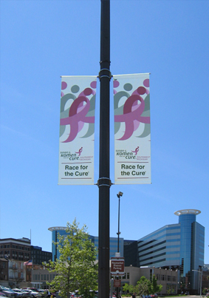
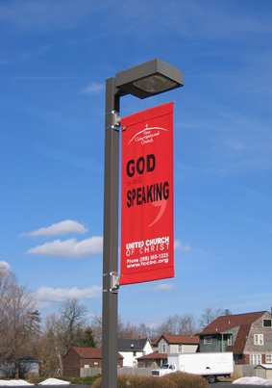
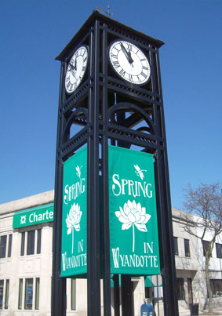
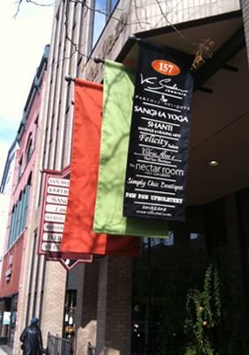
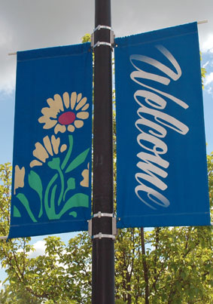
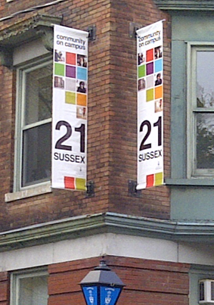

Slide 4
