Slide 1
Bicycle Parking Systems

Slide 2
Cora began to design and build bicycle racks in the early 1980's
Cora racks are available in either powder coated, galvanized or stainless steel
Expo Series ® racks come in 4 sizes; space for 4 to 10 bicycles
The Cora Expo Series® is guaranteed against defects in workmanship and materials for 20 years

Slide 3
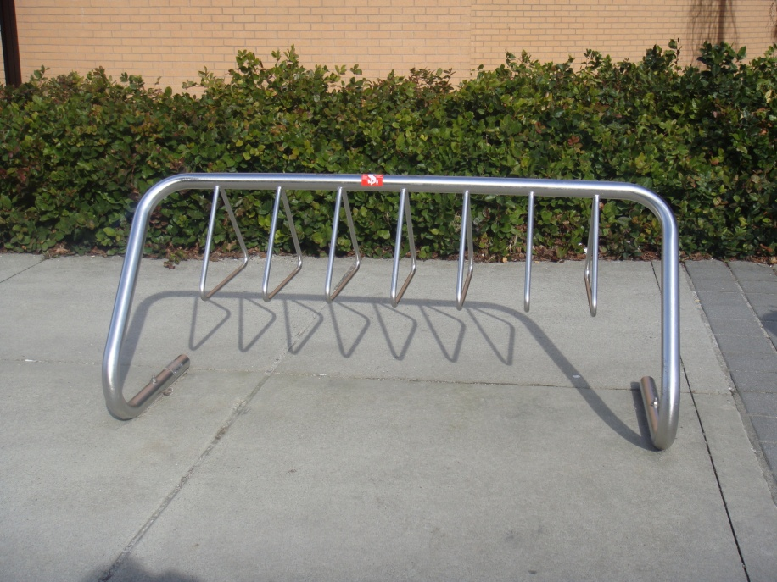
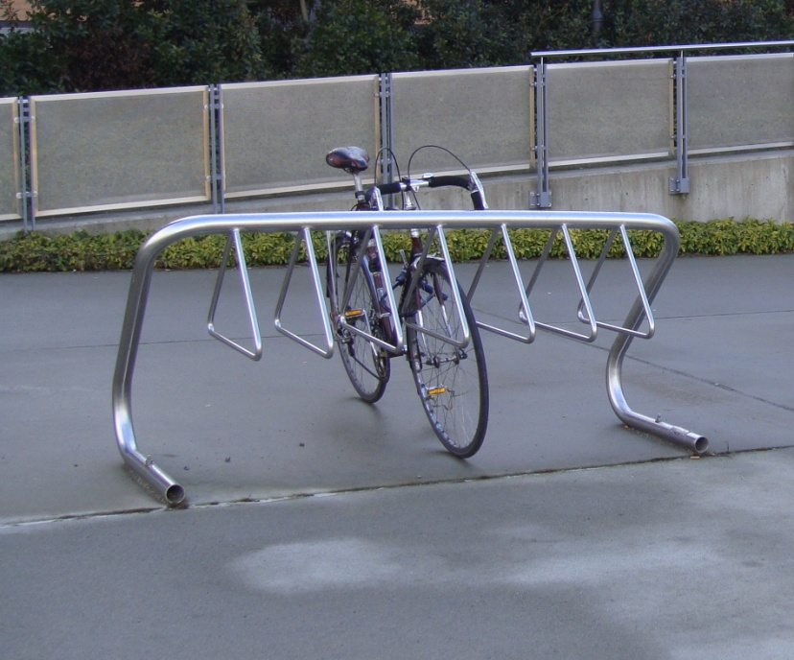
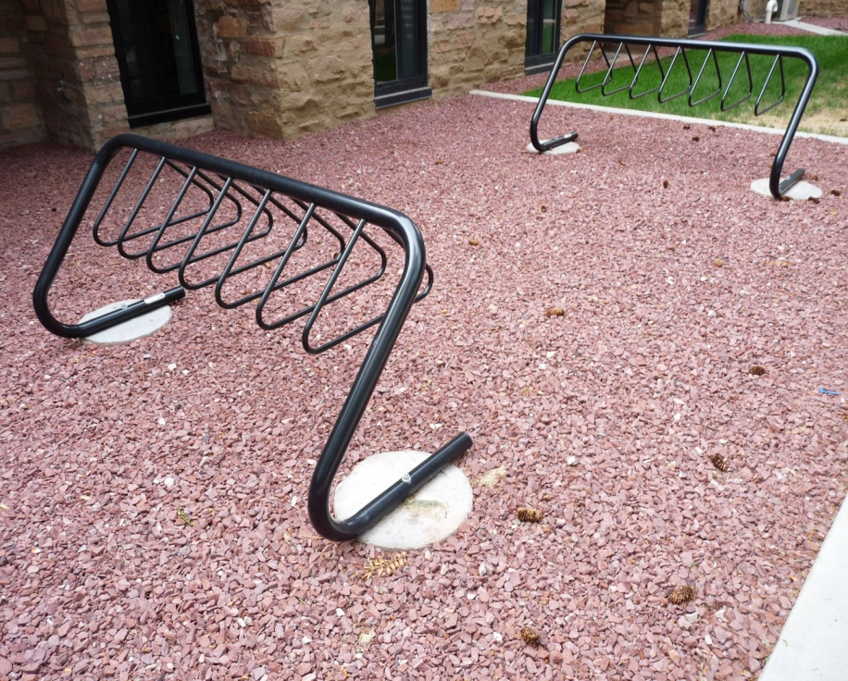
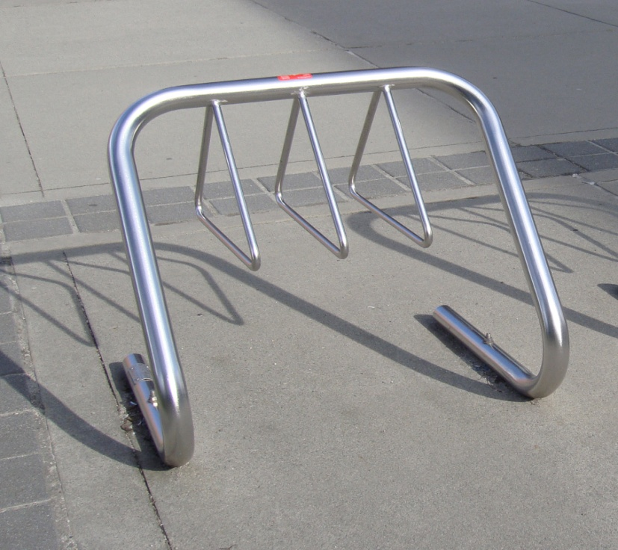

Slide 4
Color Options
sky blue | royal blue | midnight blue
teal | evergreen | hunter green
spartan bronze | statuary bronze | walnut
black | pumpkin | peking grey
baron red | burgundy

